Slide 1
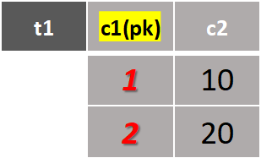
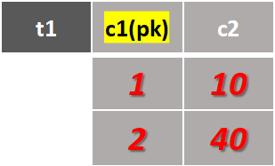
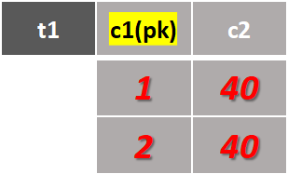
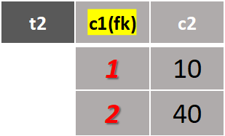
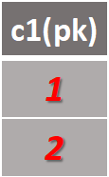
Original DML
Post-State S1 (may vary in values)
Pre-State S
UPDATE t1
INNER JOIN t2
ON (t1.c1<=t2.c1)
SET t1.c2=t2.c2
Result1(t1.1<=t2.1)
Result2(t1.1<=t2.2)
(Same predicate)
(Same affected rows)
SELECT DISTINCT
t1.c1
FROM t1
INNER JOIN t2
ON (t1.c1<=t2.c1)
(a) Matched-Row Extraction
State-Effect Token Set E(q,S)
Derived Matching Query (match_sql)
Pre-State S
INSERT INTO
t1(c1,c2)
SELECT
t1.c1+2,40
FROM t1
WHERE t1.c1>1
Post-State S1
t1 | c1(pk) | c2
 | 1 | 10
 | 2 | 20
 | 4 | 40
c1(pk) | Row hash
4 | 40
State-Effect Token Set E(q,S)
Original DML
(b) Changed-Row Extraction
Diff & Normalize

